Slide 1
Visible Light Communication (VLC)
Kukuh Satrio Wibowo

Slide 2
Description
Light Communication (LightCom) is device to sent data (audio and text) using wireless communication technology with infrared or visible light spectrum for high speed data communication.

Slide 3
Tools and Software
Tools
Arduino Nano (3x)
Arduino Uno 1x
High Power LED SMD 3535
Keyboard
Speaker
LCD 16 X 2
Software
Arduino IDE
Grovy Music Player

Slide 4
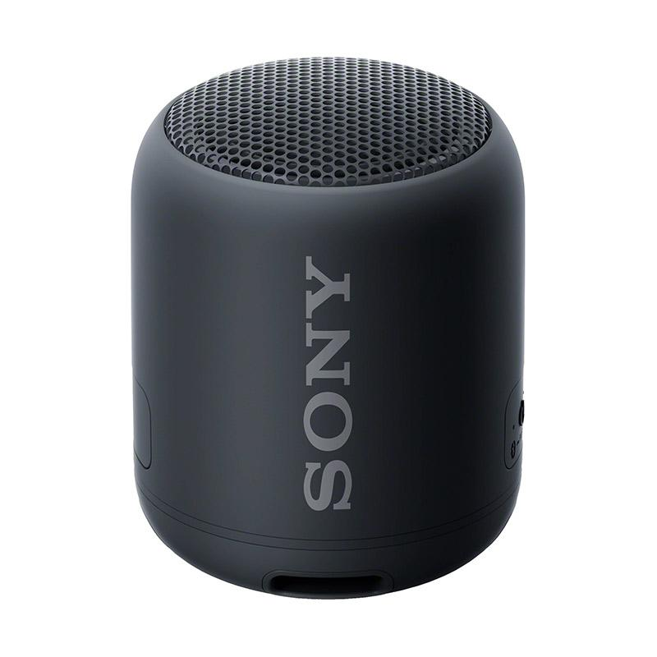
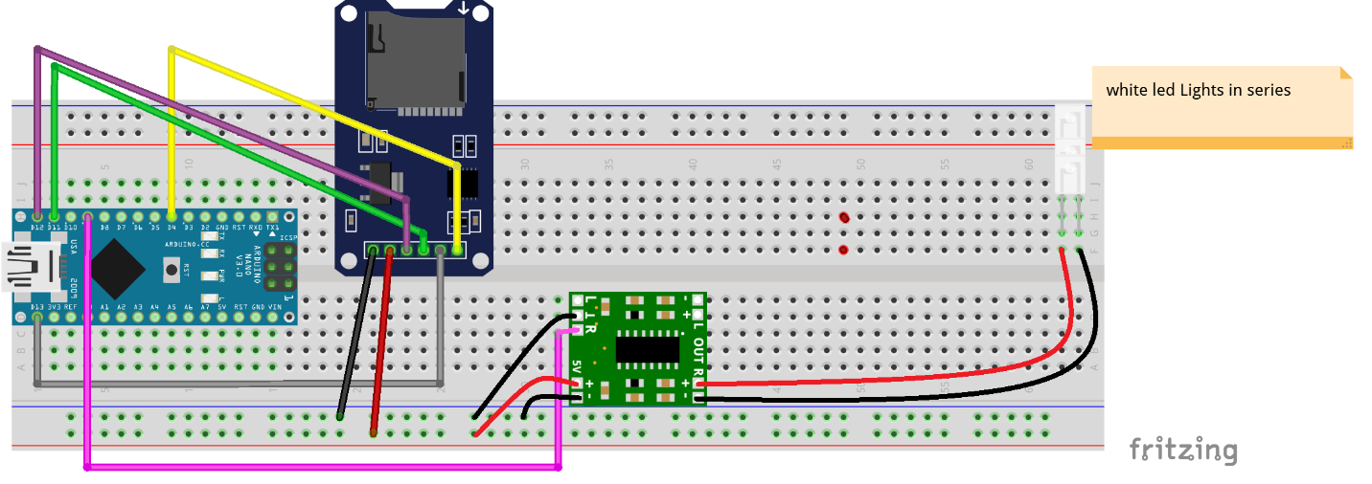
Schematic VLC Sent Audio

Slide 5
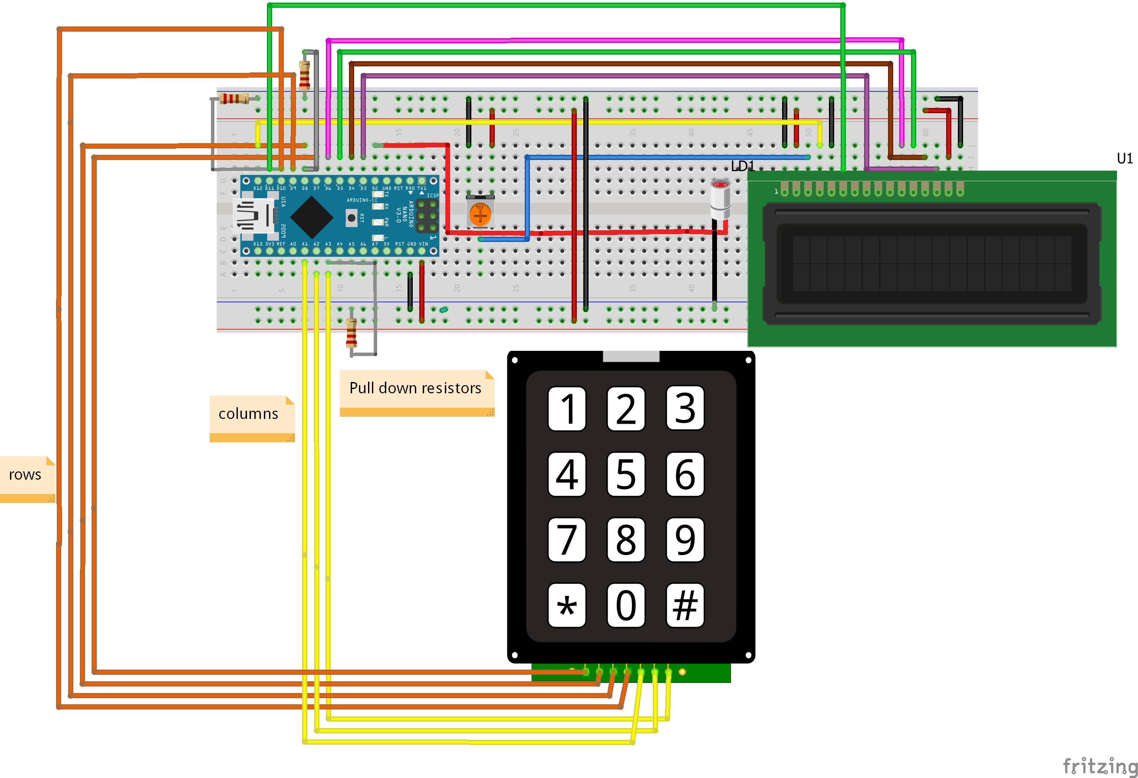
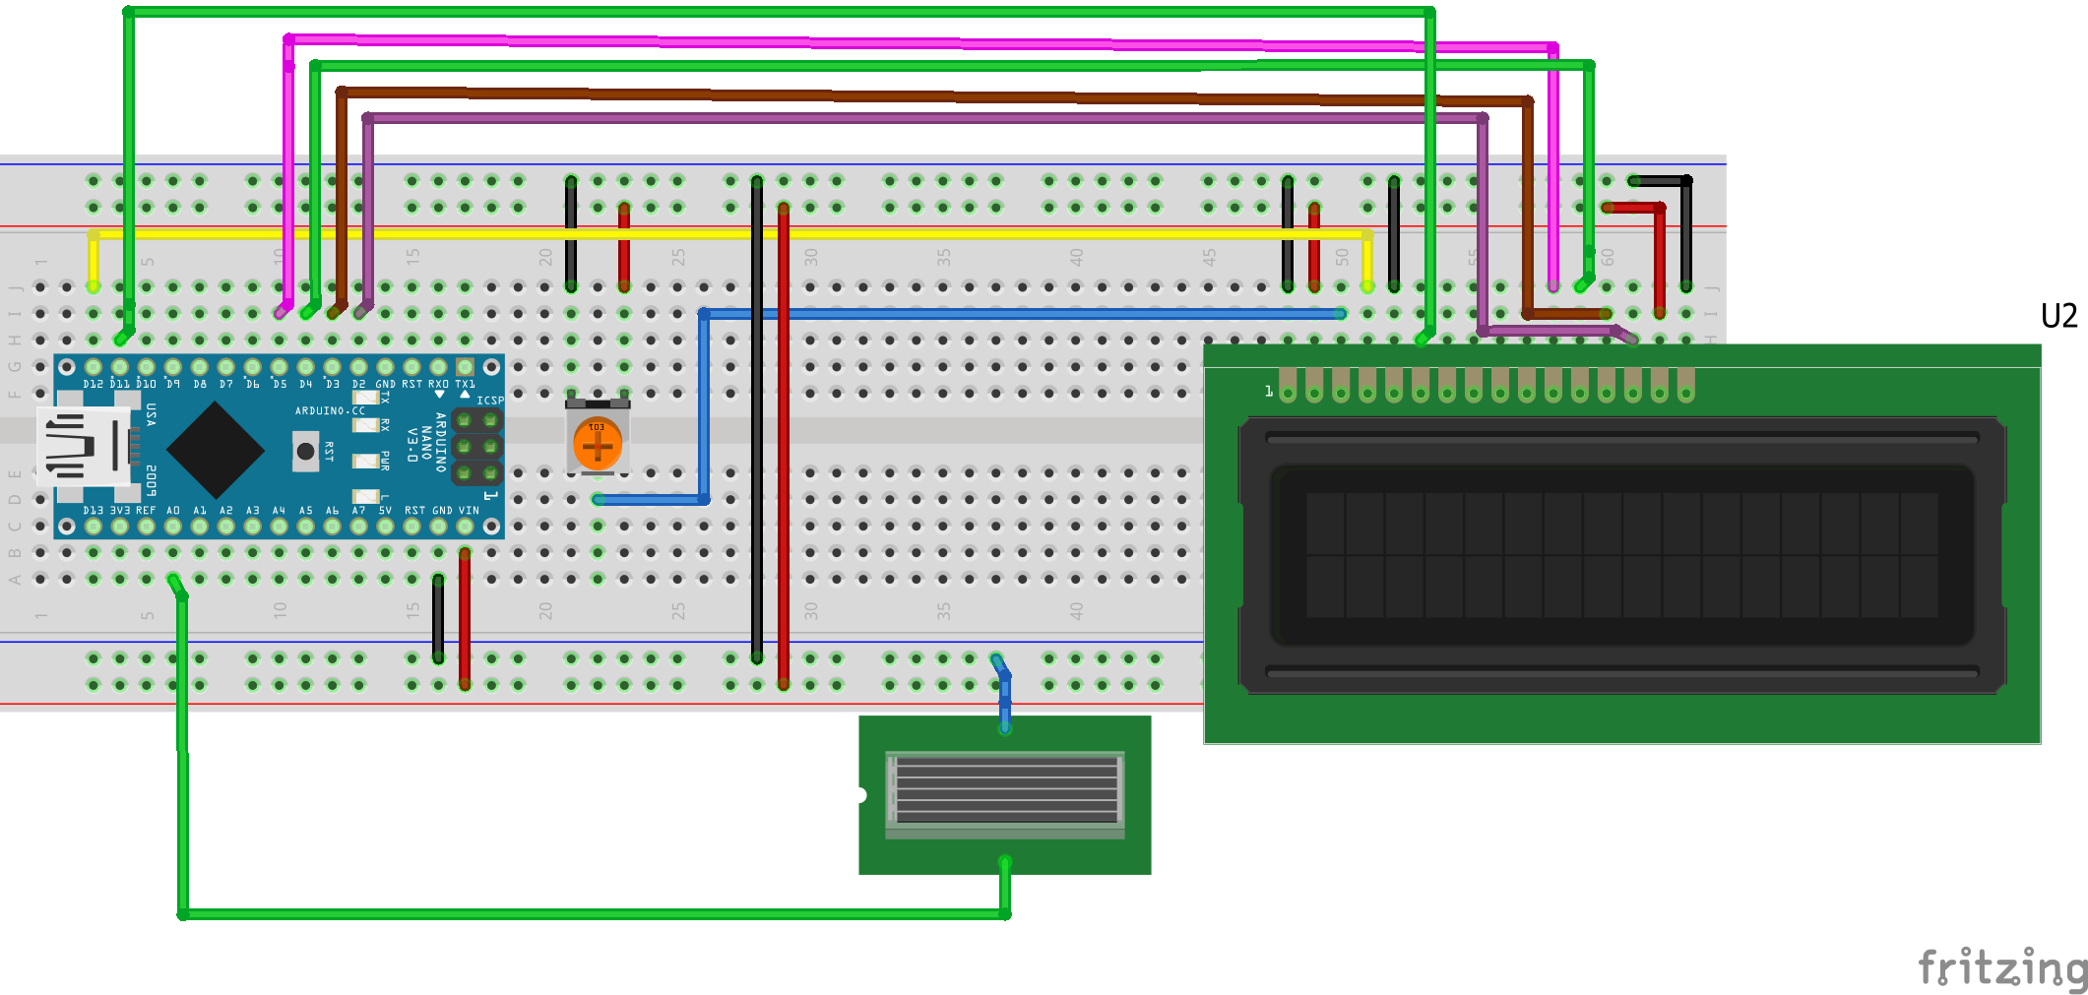
Schematic VLC Sent Text

